Slide 1
Fitting computational models of behavior(u)r
SASQUATCH
October 18th, 2018

Slide 2
*See also Huys, Maia, & Frank, 2016 Nature Neuroscience
Advantages of computational models:
Provide mechanistic explanations for cognition
Unambiguous definitions of cognitive phenomena (doesn’t mean they’re correct!)
Relevant to explain cognitive impairments/illnesses

Slide 3
Fitting computational models
Popular models
Reinforcement Learning
Drift Diffusion Models – Next time?
Code available at: https://github.com/alsfilip/Model_Fitting_Tutorial

Slide 4
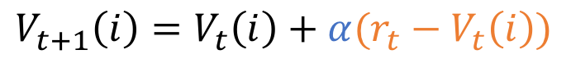
Reinforcement Learning
Use feedback/reward to guide learning (Sutton & Barto, 1998)
Learning Rate
$$V_{t+1}\left(i\right)=V_{t}\left(i\right)+α(r_{t}−V_{t}\left(i\right))$$
Value for an
action/option i
Reward prediction error

Slide 5
Two-armed bandit task
70% Reward
30% Reward
Participant’s goal is to maximize reward
Use reward feedback to find the best option to select

Slide 6
Two-armed bandit task
Value (Vt):
.5
.5
Value (Vt+1):
.5 + learning(1 - .5)
.5
.5 + .25(1 - .5) = .65
.5 + .90(1 - .5) = .95

Slide 7
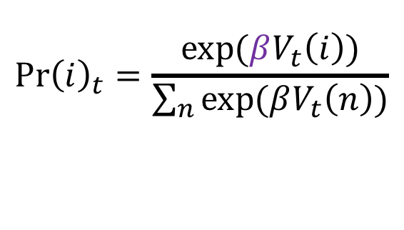
Reinforcement Learning
Use feedback/reward to guide learning (Sutton & Barto, 1998)
Learning Rate
$$V_{t+1}\left(i\right)=V_{t}\left(i\right)+α(r_{t}−V_{t}\left(i\right))$$
Value for an
action/option i
Reward prediction error
Inverse Temperature
“Greediness” parameter
$${\operatorname{Pr}\left(i\right)}_{t}=\frac{exp⁡(βV_{t}\left(i\right))}{\sum_{n}{exp⁡(βV_{t}\left(n\right))}}$$
Probability of choosing
action/option i

Slide 8
Two-armed bandit task
Choice Probability:
exp(Beta .65)/
[exp(Beta .65)+exp(Beta .5)]
exp(Beta .5)/
[exp(Beta .65)+exp(Beta .5)]
exp(.5 .65)/
[exp(/.5 .65)+exp(.5 .5)]
exp(.5 .5)/
[exp(.5 .65)+exp(.5 .5)]
.52
.48

Slide 9
Two-armed bandit task
Choice Probability:
exp(Beta .65)/
[exp(Beta .65)+exp(Beta .5)]
exp(Beta .5)/
[exp(Beta .65)+exp(Beta .5)]
exp(10 .65)/
[exp(/10 .65)+exp(10 .5)]
exp(10 .5)/
[exp(10 .65)+exp(10 .5)]
.82
.18

Slide 10
Fitting
Open “RL_example.m”
Code available at: https://github.com/alsfilip/Model_Fitting_Tutorial

Slide 11
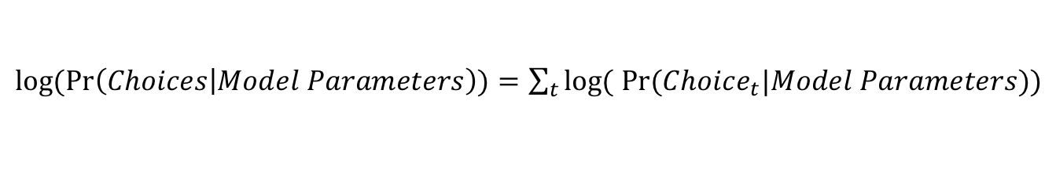
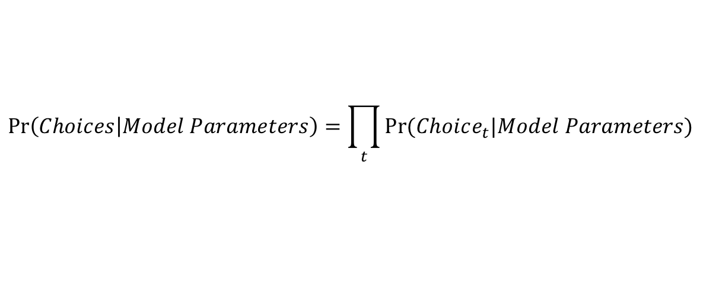
Loss function
Likelihood
Log-Likelihood
Maximize the log likelihood/ Minimize the negative log-likelihood
$$\operatorname{Pr}\left(Choices | Model Parameters\right)=\prod_{t}{Pr⁡(Choice_{t}|Model Parameters)}$$
$log(Pr\left(Choices | Model Parameters\right))=\sum_{t}{log⁡(}$ $Pr⁡(Choice_{t}|Model Parameters))$

Slide 13
Palminteri et al., 2017

Slide 14
Guidelines for Model fitting:
1) Define a task that challenges the computational models used – use task to make behavioral predictions
2) Ensure parameter recovery/Model Discrimination
3) Model comparison (e.g., AIC, BIC, model evidence, cross validation)
4) Simulate behavior – ensure that winning model reproduces the observed behavior
Palminteri et al., 2017

Slide 15
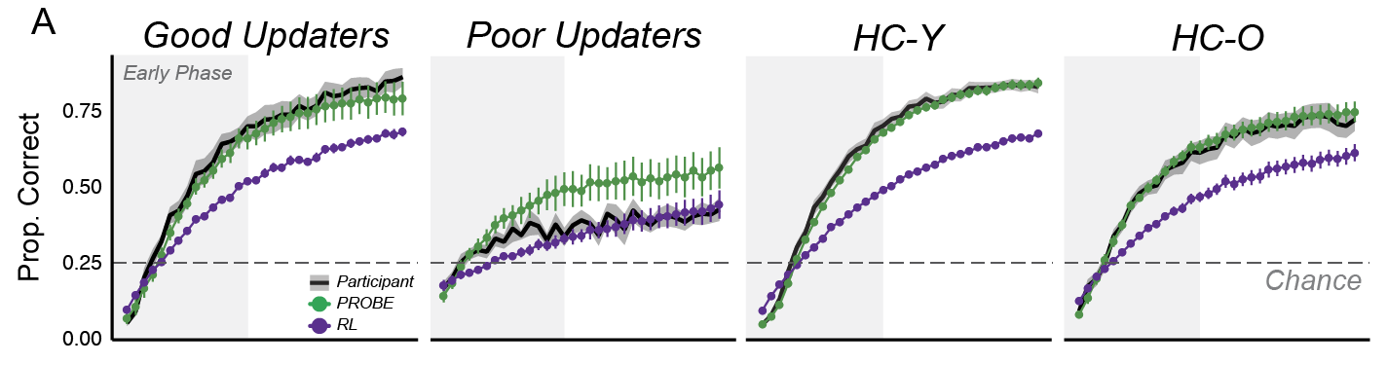
Trials Since Last Rule Switch
Filipowicz et al., in prep

